Slide 1
Irony Detection Using Transformers
Presenting by,
Megha Eldho
Krishnapriya Krishnan Santhadevi
Sharik Anwar Zahir Hussain
Dheenadayalan Tamilarasan Muthuselvi

Slide 2
Introduction
Context of Irony in Social Media
The evolution of social networks has led to an increased use of sarcastic and ironic expressions in public posts. This is done to present one's views in a concise, effective and attractive manner.
Irony detection and classification have become essential in various real-world scenarios, including sentiment analysis, online harassment detection, author profiling, and analyzing diverse viewpoints.

Slide 3
The focus of the research is to determine whether a given tweet is ironic. Further classifying tweets into four categories: non-ironic, verbal irony with contrast, verbal irony without contrast, and situational irony.
Previous works on irony detection emphasized linguistic details of the English language, but this study deviates by employing Transformer models such as BERT and XLNets.
Unlike sequential text processing, these bidirectional autoencoder linguistic models are trained to understand word context more accurately. XLNet, utilizing the permutation method, is contrasted with BERT's MASK method.
Four key metrics—accuracy, precision, recall, and F1 score—are employed to compare the proposed models' performance with that of previous papers, highlighting the advancements in irony detection using Transformer-based approaches.

Slide 4
Previous Works
This paper highlights several methodologies adopted in prior research, such as densely connected LSTM networks (THUNGN), Siamese neural nets with Glove word embeddings (Irony Magnet), ensemble soft voting classifiers using LR and SVM (WLV), and combinations of Bi-LSTMs with self-attention mechanisms (NTUA-SLP).
They have employed various architectures, combining LSTM networks, convolutional neural networks (CNN), and Multilayer Perceptrons (MLP) to address irony detection tasks.
Initialization of models with different word embeddings (such as word2vec embeddings) and the use of feature sets containing semantic, sentiment, lexical, and syntactic features are highlighted in different approaches.
Assessment of Supervised Learning Algorithms for Irony Detection in Online Social Media discusses the performance of different models based on evaluation metrics like accuracy, precision, recall, and F1-score.
This suggests that the primary focus of the paper lies in exploring and utilizing the advanced transformer-based models such as BERT and XLNet.

Slide 5
Methodology
Objective: Address SemEval's irony detection problem using innovative Transformer models, focusing on binary and multi-class classification.
Preprocessing :
Modify tweets by removing hashtags, replacing user mentions and web links, while retaining punctuations.
Enhance data analysis by replacing emojis and emoticons with descriptive text using the emot Python library.
Model Implementation : Utilize the HuggingFace library for BERT and XLNet models.

Slide 6
Implementation
BERT Implementation:
BERT is constructed on the Transformer encoder stack. Leverages semi-supervised sequence learning approaches in Natural Language Processing (NLP).
Takes a sentence as input to comprehend contextual relationships between words.
Implements an attention mechanism where a mask randomly selects a word in a sentence. Predicts the context of the selected word based on its surrounding words.
Two sizes: Base (12 transformer blocks) and Large (24 transformer blocks).
Fine-tuned the Tensorflow-based BERT-base model on the dataset.

Slide 7
Cont’d
XLNet Implementation:
XLNet is a generalized auto-regressive language model built on Transformer-XL.
Utilizes recurrence mechanism for long-term dependencies and relative positional encoding for context.
Implements Permutation Language Modeling (PLM) for bi-directional context without needing a mask.
Fine-tuned the XLNet model on the dataset using HuggingFace library.

Slide 8
Hyperparameters
Task | Model | Hyperparameters
A | BERT-base | lr=3e-5,bs=32,epochs=5,Steps per epoch=7 optimizer=Adam
B | BERT-base | lr=3e-5,bs=32,epochs=5,Steps per epoch=7 optimizer=Adam
A | XLNet | lr=3e-5,bs=32,epochs=5,Steps per epoch=7 optimizer=Adam
B | XLNet | lr=3e-5,bs=32,epochs=5,Steps per epoch=7 optimizer=Adam

Slide 9
Evaluation
Dataset sourced from 'SemEval-2018 Task 3: Irony detection in English tweets.'
SubTask A: 3817 English tweets (1901 ironic, 1916 non-ironic) in training; 784 tweets (311 ironic, 473 non-ironic) in the test set.
SubTask B: 3817 tweets in training; test set with 784 samples (473 non-ironic, 164 ironic with polarity contrast, 85 situational ironic, 62 ironic without polarity contrast).

Slide 10
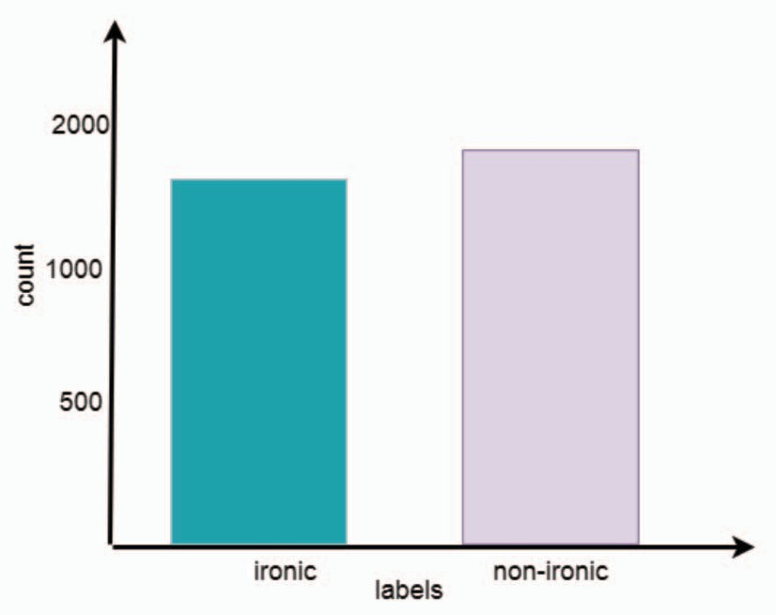
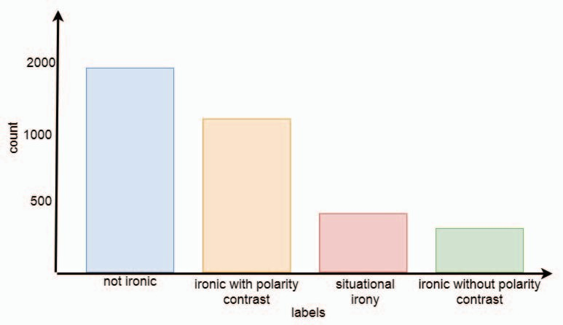
SubTask A
SubTask B

Slide 11
Evaluation Metrics:
Chosen metrics: accuracy, precision, recall, and F1 score.
F1 score is used for comparing the performance of different models.
Results:
Task A : Binary Classification (Ironic/Non-Ironic)
Table showcases results using BERT and XLNet.
XLNet outperformed BERT and surpassed state-of-the-art results.
Model | Epochs | Accuracy | Precision | Recall | F1 Score
BERT | 3 | 0.66 | 0.75 | 0.66 | 0.70
XLNet | 5 | 0.70 | 0.79 | 0.70 | 0.74
Semeval Reference | - | 0.73 | 0.63 | 0.80 | 0.70

Slide 12
Conclusion
Transformer-Based Solution : Proposed BERT and XLNet transformer models for Task 3 of SemEval-2018, focusing on irony detection in English Tweets.
Successfully utilized BERT and XLNets to enhance contextual understanding of words in tweets, achieving accurate irony detection and classification.
Future Enhancements:
Plan to incorporate emojis for improved sentiment analysis in tweets, enhancing the models' understanding of irony.
Explore sampling techniques to refine the multiclass classification model.
Consideration for future work includes exploring the BERT large model with increased hidden and attention layers for more computational intensity, aiming to improve overall results.

Slide 13
Thank You

